Slide 1
2.4 Creating, Moving and Deleting Files
How to Prepare for the LPI Linux Essentials Certification Exam
C851 Cohort Session for Sunday, August 8, 2021
Dr. John S. Galliano | C851 Linux Foundations Instructor

Slide 2
Agenda
Welcome
About the Exam
The 5 Exam Domains
Topics/Weightings
LPI Retake Policy
Demos/Hands-on
Sample Exam Questions
Wrap-Up

Slide 3

About the Linux Essentials v1.6
No prerequisites
Closed book, up to 60 minutes
40 multiple-choice (with some multi-select and fill-in-the-blank items) questions
Minimum pass score 500 points (200-800 scale)
Partially correct responses not accepted (for F-I-T-B questions LPI may accept multiple correct versions of an answer¹
The total exam weight count is 40, thus 40 questions. For each topic area, if an objective has a weight of 4, there will be 4 questions on the exam related to the objective.
1. Example: with/without leading path in a case where the answer is a command

Slide 4

5 Exam Domains²
The Linux Community and a Career in Open Source
Finding Your Way on a Linux System
The Power of the Command Line
The Linux Operating System
Security and File Permissions
2. https://wiki.lpi.org/wiki/Linux_Essentials_Objectives_V1.6#Introduction
Notes:
• Understanding the Linux industry and the open source movements
• Understanding the major components of a Linux distribution
• Gaining the technical proficiency to work on the Linux command line
• Gaining a basic understanding of security and administration in Linux
• Gaining a basic understanding of how to work with users, groups, and permissions

Slide 5

Exam Topics/Weightings
Linux Essentials v1.6 Exam Topics³ | 1.1 | 2
 | 1.2 | 2
 | 1.3 | 1
 | 1.4 | 2
 | 2.1 | 3
 | 2.2 | 2
 | 2.3 | 2
 | 2.4 | 2
 | 3.1 | 2
 | 3.2 | 3
 | 3.3 | 4
 | 4.1 | 1
 | 4.2 | 2
 | 4.3 | 3
 | 4.4 | 2
 | 5.1 | 2
 | 5.2 | 2
 | 5.3 | 2
 | 5.4 | 1
 |  | 40
A weight of “1” equates to 1 exam question
3. https://wiki.lpi.org/wiki/Linux_Essentials_Objectives_V1.6#Objectives

Slide 6

LPI Exam Re-Take Policy⁴
Anyone who takes an LPI exam once must wait one week before re-taking
Anyone who takes an LPI exam a second (and subsequent) time must wait 30 days before re-taking
Anyone who passes an LPI exam may not retake that exam for two years
4. LPI, at https://www.lpi.org/policies

Slide 7
2.4 Creating, Moving and Deleting Files⁵
Weight: 2
Key Knowledge Areas:
Files and directories
Case sensitivity
Globbing
Files used, terms, and utilities:
mv, cp, rm, touch
mkdir, rmdir
5. Linux Professional Institute at https://www.lpi.org/our-certifications/exam-010-objectives

Slide 8
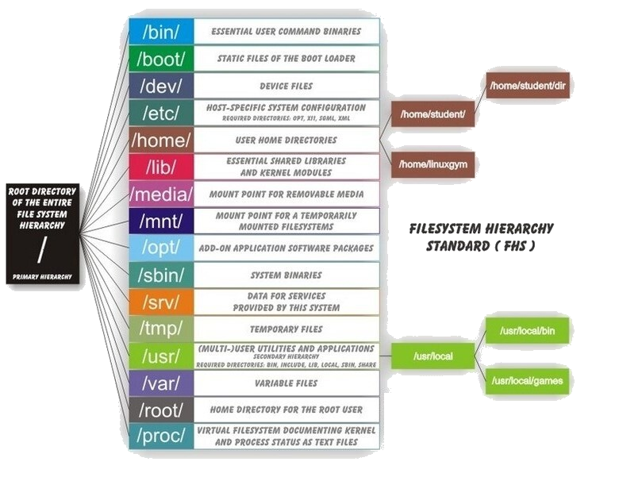
The File Hierarchy System (FHS)⁶
Maintained by the Linux Foundation
Used in all Unix-like operating systems
Defines directory structure/contents in Linux distributions
All files and directories appear under the root directory or “ / ”
6. The Linux handbook at https://linuxhandbook.com/linux-directory-structure/

Slide 9
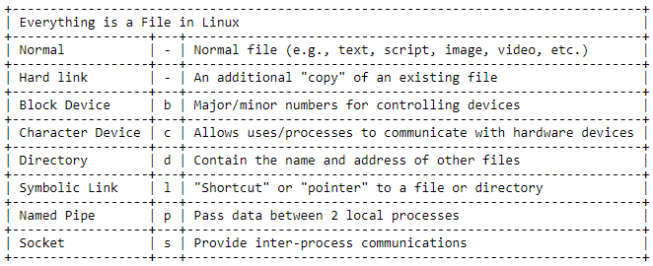
True or False? Everything in Linux is a file.
TRUE

Slide 10
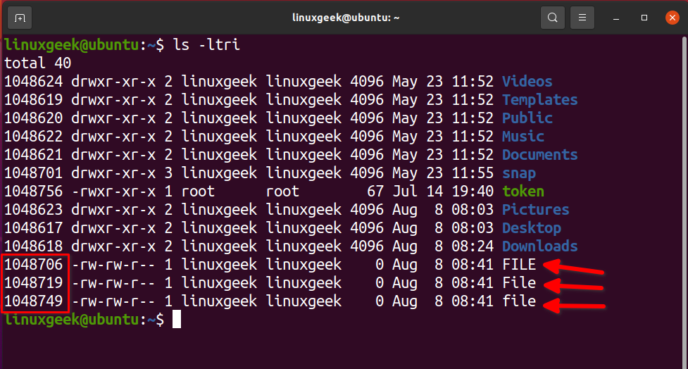
Case Sensitivity

Slide 11
Globbing?
A Question mark ? – matches a single occurrence of any character
An asterisk * – matches one or more characters, including none
A bracket [ ] – matches any occurrence of characters in the square brackets
?, *, or [ ]
https://man7.org/linux/man-pages/man7/glob.7.html

Slide 12
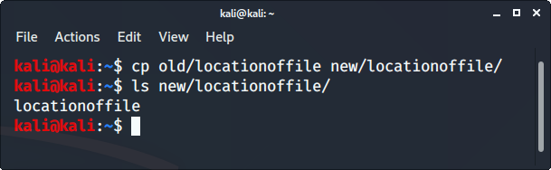

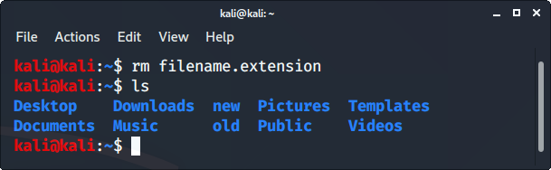
mkdir, rmdir
mkdir newfolder #creates a folder called newfolder
mv newfolder newfolder2 #renames folder to be newfolder2
mv newfolder folder/newfolder #moves newfolder into the folder directory
cp -r newfolder newfolder.bak #copies newfolder and contents to newfolder.bak Note: -r option recursively copies folder and all contents
rm -rf newfolder #deletes newfolder and all contents. Use -f (force) option for protected files within directory

Slide 13
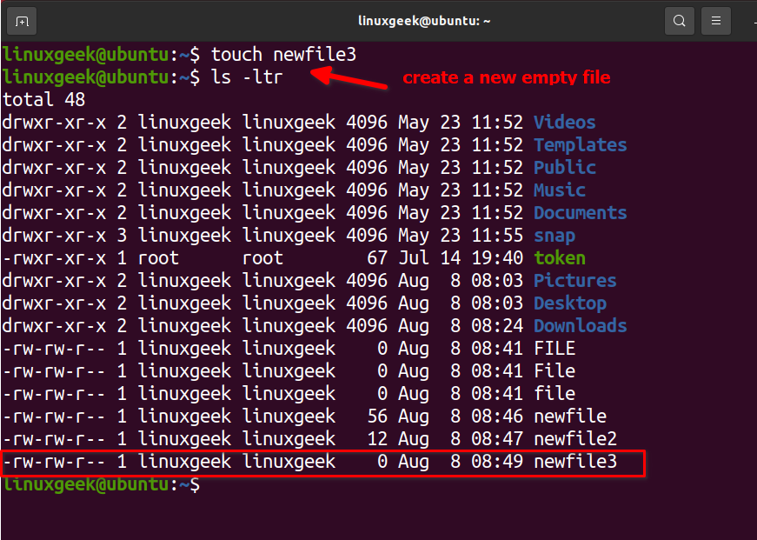
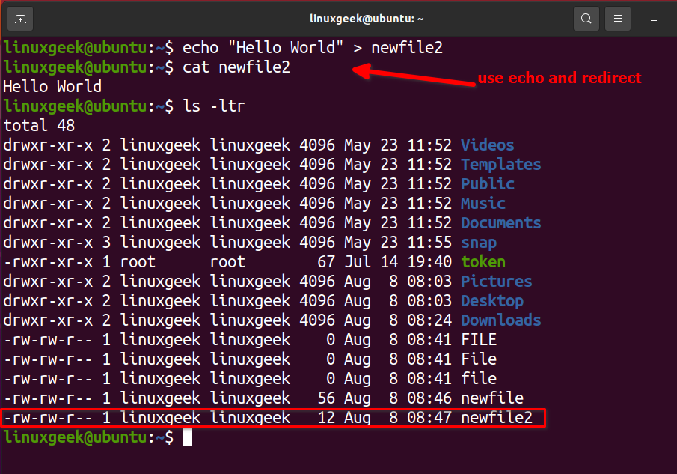
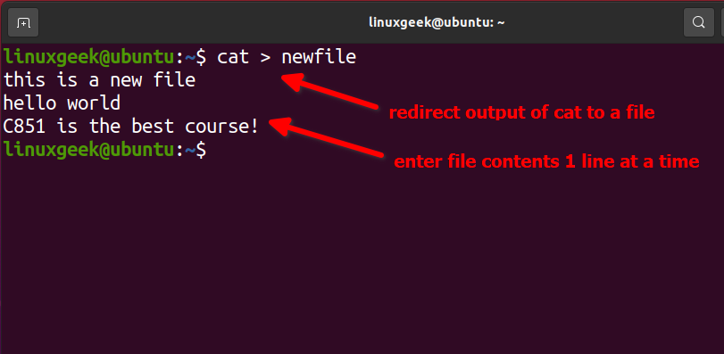
cat, echo, touch
3 ways to create files: cat, echo touch
cat: create a file with content
echo: put content into a new file
touch: create a file without content (empty file)

Slide 14

Let’s Do Some Demos!
If you want to follow along, fire up your VM
Notes:
• Understanding the Linux industry and the open source movements
• Understanding the major components of a Linux distribution
• Gaining the technical proficiency to work on the Linux command line
• Gaining a basic understanding of security and administration in Linux
• Gaining a basic understanding of how to work with users, groups, and permissions

Slide 15
What Questions Do you Have for Me?

Slide 16
Backup
Linux has 3 basic file types:
Ordinary/regular files
Directories
Special files
Directories store:
store ordinary and other special files
organized in a hierarchy starting from the root (/) directory
Special files communicate or point:
block files with device drivers
character files via unbuffered serial access with system hardware (1 character at a time)
pipes/named pipes for inter-process comms, connecting the output of one process to the input of another process
socket files to transfer data and information between processes running in different environments
symbolic links reference another file (think of these links as “pointing” to other files like directories or regular files)

Slide 17
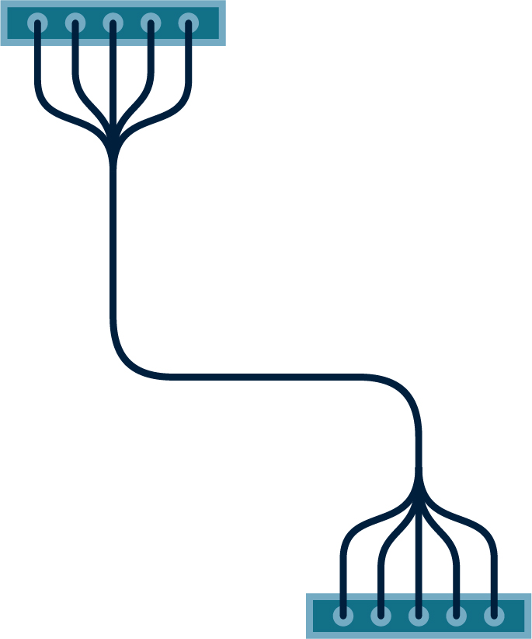






























Icon Library - Page 1

Slide 18



























































Icon Library - Page 2

